Slide 1
Happiness on GDP per Capita
Stephany Palmer
Julia Lewis

Slide 2
The Burning Question...
Is there a way we can predict GDP per Capita through the data used to calculate the happiness score of a country?

Slide 3

The World Happiness Report
Which countries rate in overall happiness?
First published in 2012
Polled individuals from different countries against Dystopia (a place no one wants to be)
Used to make informed political decisions
Assesses whether countries are progressing
Instead of measuring the overall happiness of a country, we measure GDP using the given variables.
Notes:
Answers the question … which countries rate in overall happiness?
People are polled (Gallup World Poll) against a hypothetical country Dystopia
Dystopia has the world’s least happy people, used as a benchmark so that other countries can be favorably compared

Slide 4
The Variables | Notes
GDP per Capita | Our independent variable, the natural log of GDP per capita as used in equation by Gallup.
Family | If you were in trouble, do you have relatives or friends you can count on to help you whenever you need them?
Life expectancy | Based on data from the World Health Organization data repository
Freedom | Are you satisfied or dissatisfied with your freedom to choose what you do with your life?
Generosity | Have you donated money to charity this month?
Corruption Perception | Is corruption widespread throughout the government or not?
Notes:
Asked random people some questions

Slide 5
Goal: Get the best model possible

Slide 6
First order model
Model:
Statistics:
p-value<2.2e-16
Ra^2 = 0.7737
S = 0.2002

Slide 7
Forward Stepwise Regression
Model:
Statistics:
p-value<2.2e-16
Ra^2 = 0.7751
S = 0.1995
Anova:
A useful model in predicting GDP, but not a better model than the linear model.

Slide 8
Backward Stepwise Regression
Same as forward stepwise linear model.
Linear model is still better.

Slide 9
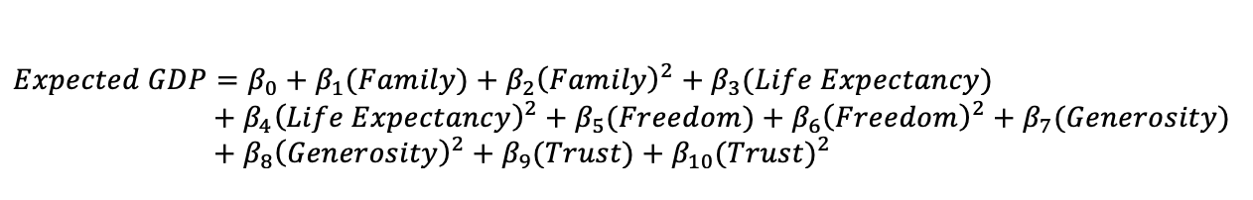
Second order model
Model:
Statistics:
p-value<2.2e-16
Ra^2 = 0.776
S = 0.1992
Anova:
A useful model, but not better than the linear model.

Slide 10
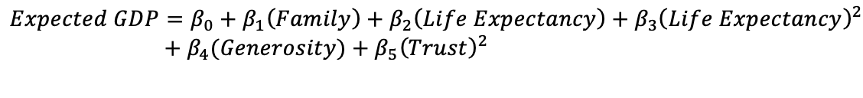
Stepwise Regressions of 2nd Order model
Model:
Statistics:
p-value<2.2e-16
Ra^2 = 0.7817
S = 0.1966
Anova:
A useful model, but not better than the linear model.
* Does not have the main effect for Trust
Notes:
The same models
Not better than the linear model

Slide 11
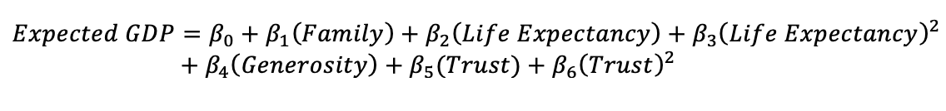
Fix wonky terms
Model:
Statistics:
p-value<2.2e-16
Ra^2=0.1973
S = 0.7802
Anova:
Finally improved upon the linear model
Notes:
Fixed 2nd order forward step regression model is now better than linear model

Slide 12
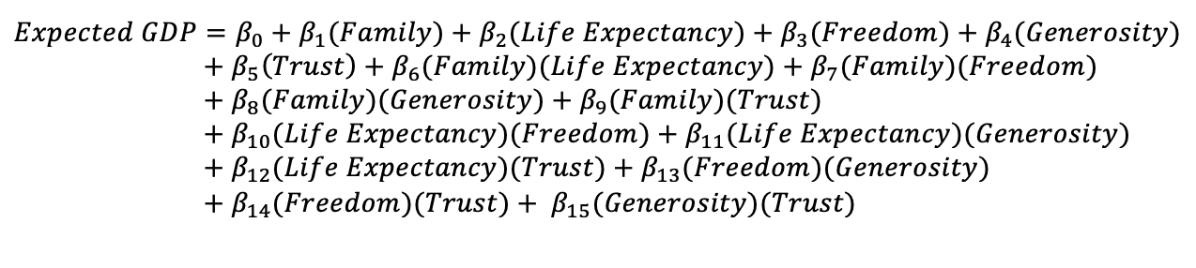
Interaction model
Model:
Statistics:
p-value<2.2e-16
Ra^2=0.8055
S = 0.1856
Anova:
Improved upon the linear and the fixed 2nd order step models.
Notes:
Better than linear model
Better than fixed 2nd order step regression model

Slide 13
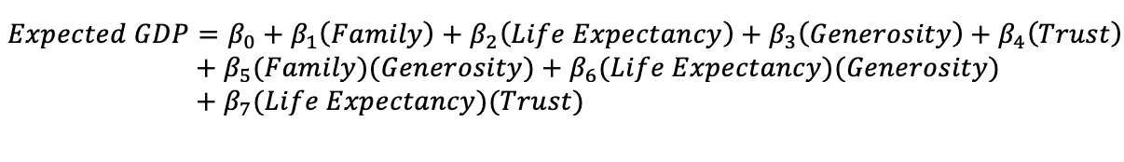
Stepwise Regressions of Interaction model
Model:
Statistics:
p-value<2.2e-16
Ra^2=0.8081
S = 0.1843
Anova:
Improved upon the linear & fixed 2nd order step models, but not the interaction model.
Notes:
Same model both step directions
Better than: linear model, fixed 2nd order step reg model
Not better than interaction model

Slide 14
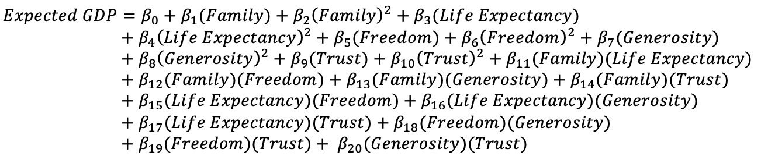
Complete second order interaction model
Model:
Statistics:
p-value<2.2e-16
Ra^2= 0.8149
S = 0.181
Anova:
Improved upon the linear & fixed 2nd order models, but not the step interaction model.

Slide 15
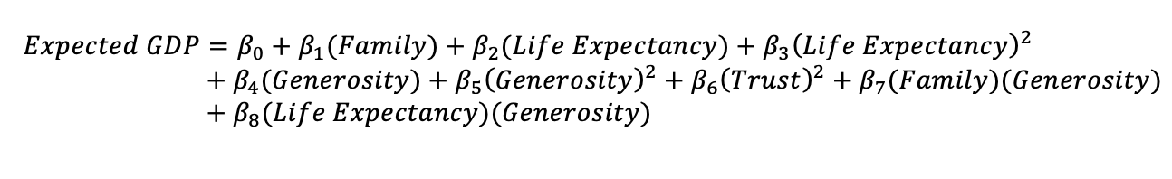
Forward Stepwise 2nd order + interaction model
Model:
Statistics:
P-value<2.2e-16
Ra^2= 0.8088
S = 0.184
Anova:
Improved upon the linear & fixed 2nd order step models, not better than the complete second order model.
*Does not have the main effect for Trust again
Notes:
Better than: linear, fixed 2nd order step
Not better than complete second order model

Slide 16
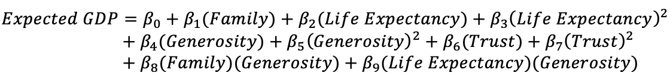
Fix the wonk
Model:
Statistics:
p-value<2.2e-16
Ra^2= 0.8076 * smaller than last 2 models
S = 0.1846
Anova:
Improved upon the fixed 2nd order step model
Not better than the previous model with Trust left out.

Slide 17
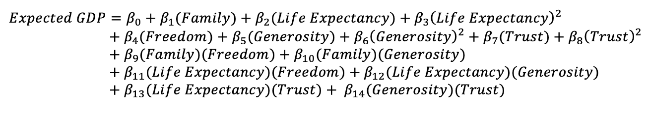
Backward Stepwise 2nd order + interaction model
Model:
Statistics:
p-value<2.2e-16
Ra^2= 0.8202
S = 0.1784
Anova:
Improved upon the stepwise interaction model
Not better than the interaction model.

Slide 18
Model | P-Value | Ra^2 | s | Wonky terms? | Notes
Linear | <2.2e-16 | 0.7737 | 0.2202 | no
Forward step linear | <2.2e-16 | 0.7751 | 0.1995 | no
Backward step linear | <2.2e-16 | 0.7751 | 0.1995 | no | same as forward linear
Second order | <2.2e-16 | 0.776 | 0.1992 | no
Forward step 2nd order | <2.2e-16 | 0.7817 | 0.1966 | yes | main effect for trust not in, but Trust^2 is
Backward step 2nd order | <2.2e-16 | 0.7817 | 0.1966 | yes | same as forward 2nd
Interaction | <2.2e-16 | 0.8055 | 0.1856 | no
Forward step interaction | <2.2e-16 | 0.8081 | 0.1843 | no
Backward step interaction | <2.2e-16 | 0.8081 | 0.1843 | no | same as forward int
Complete 2nd order | <2.2e-16 | 0.8149 | 0.181 | no
Forward step 2nd order & interaction | <2.2e-16 | 0.8088 | 0.184 | yes | no main effect Trust
Backward step 2nd order & interaction | <2.2e-16 | 0.8202 | 0.1784 | no

Slide 19
Ranking of models better than original linear model
Although by anova test the 2nd order & interaction back step model is not significantly more useful than the interaction model, it has improved Ra^2 and s, so we will choose it as the best model.
Rank | Model
1st | Interaction model
2nd | 2nd order & Interaction backward step
3rd | Interaction steps
4th | Complete 2nd order model
5th | 2nd order & Interaction forward step
6th | Fixed 2nd order & interaction forward step
7th | fixed 2nd order steps
8th | linear model

Slide 20
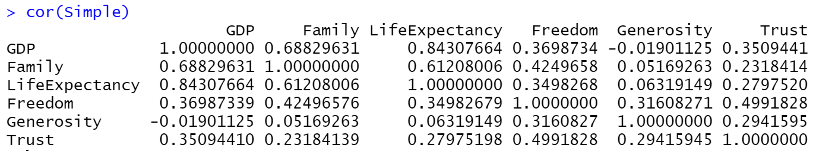
Multicollinearity
Notes:
VIF<10, not sufficient evidence of multicollinearity
Family and Life Expectancy moderately correlated

Slide 21
Check assumptions
ε is normally distributed
With a mean of 0
The variance is constant, and
All pairs of error terms are uncorrelated.

Slide 22
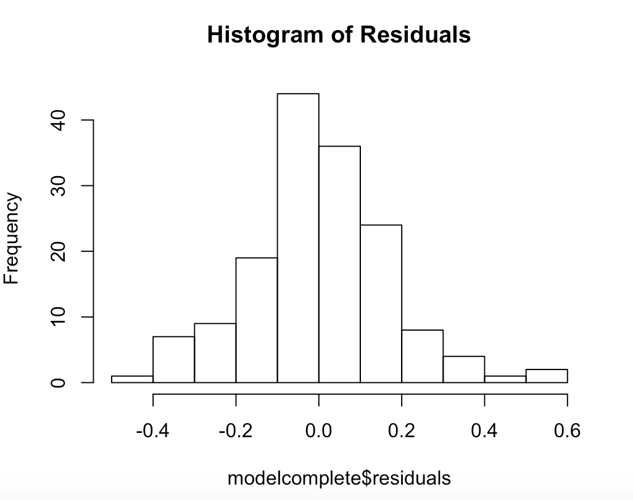
Normality
We see its mound shaped (not badly skewed, so normality assumption is ok.

Slide 23
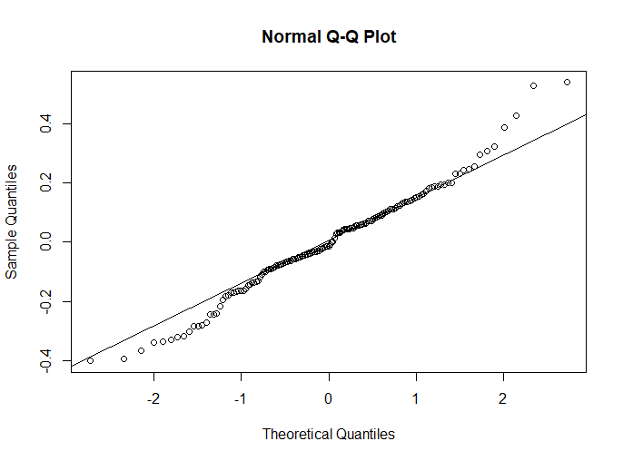
QQ plot
Roughly a straight line and is not skewed, so we again say that our data is normally distributed

Slide 24
E[ε]=0
(2) Mean of residuals is 7.74e-18.

Slide 25
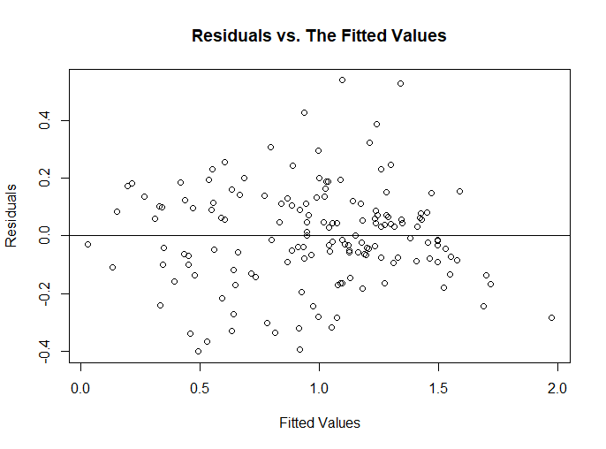
Constant Variance
(3) No obvious pattern in plot of residuals vs. fitted values, so assumption of equal variance holds.

Slide 26

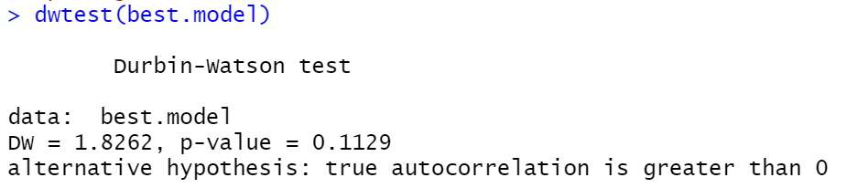
Uncorrelated Errors
With alpha = 0.05, we fail to reject the null and there is insufficient evidence to conclude any correlation in the residuals and therefore the error is independent.
Notes:
Lmtest package, null

Slide 27
Work Cited
https://www.gallup.com/file/services/177797/World_Poll_Dataset_Details_092520.pdf
https://worldhappiness.report/ed/2020/social-environments-for-world-happiness/
Helliwell, J., Layard, R., & Sachs, J. (2017). World Happiness Report 2017, New York: Sustainable Development Solutions Network.

